Slide 1
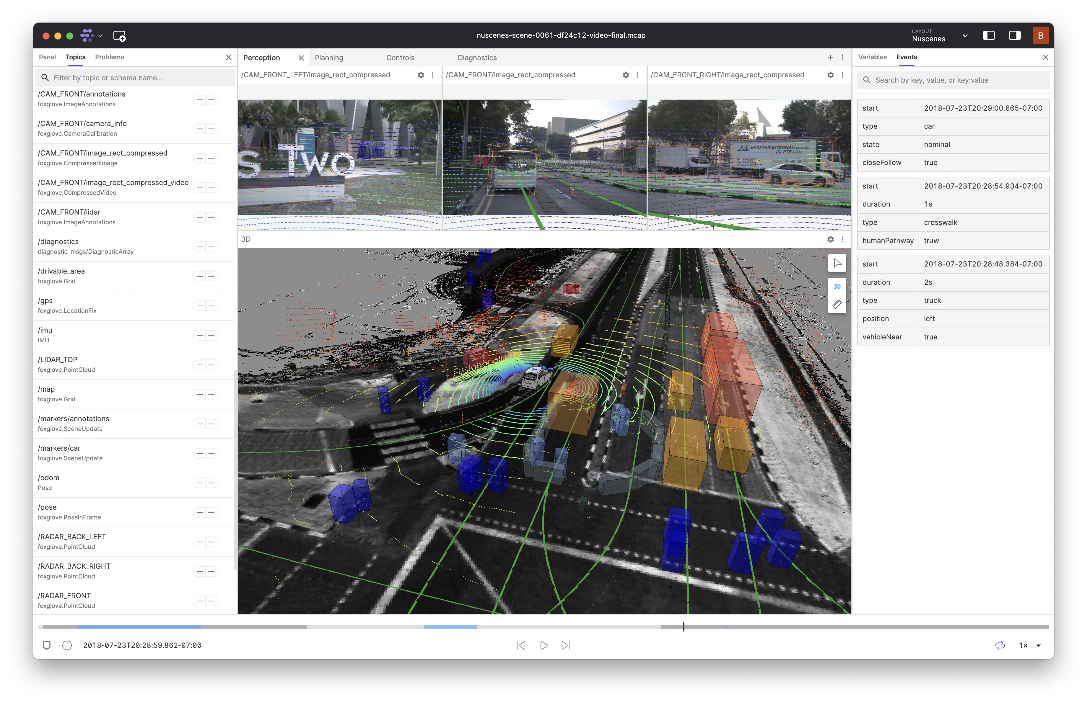
Visualization Demo of Autonomous Driving Scene Analysis Using Waymo Dataset
Presented By: Jingjie Qian, Malia Howe, Rongxuan Zhou

Slide 2
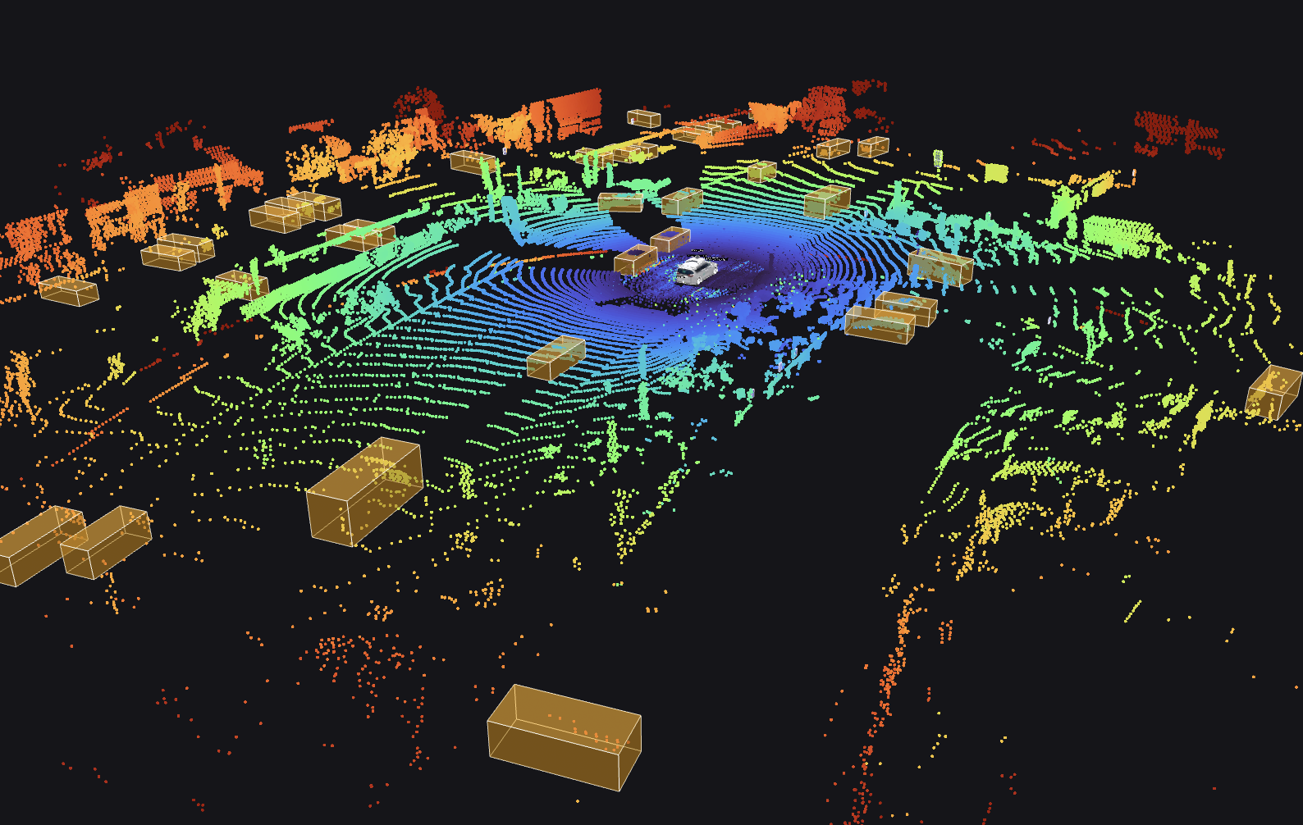
Contents
1. Motivation
2. Data Source & Background
3. Methodology
4. Visualization Demo
5. Contributions
6. Future Works
7. References
8. Task Allocation

Slide 3
Motivation
01

Slide 4
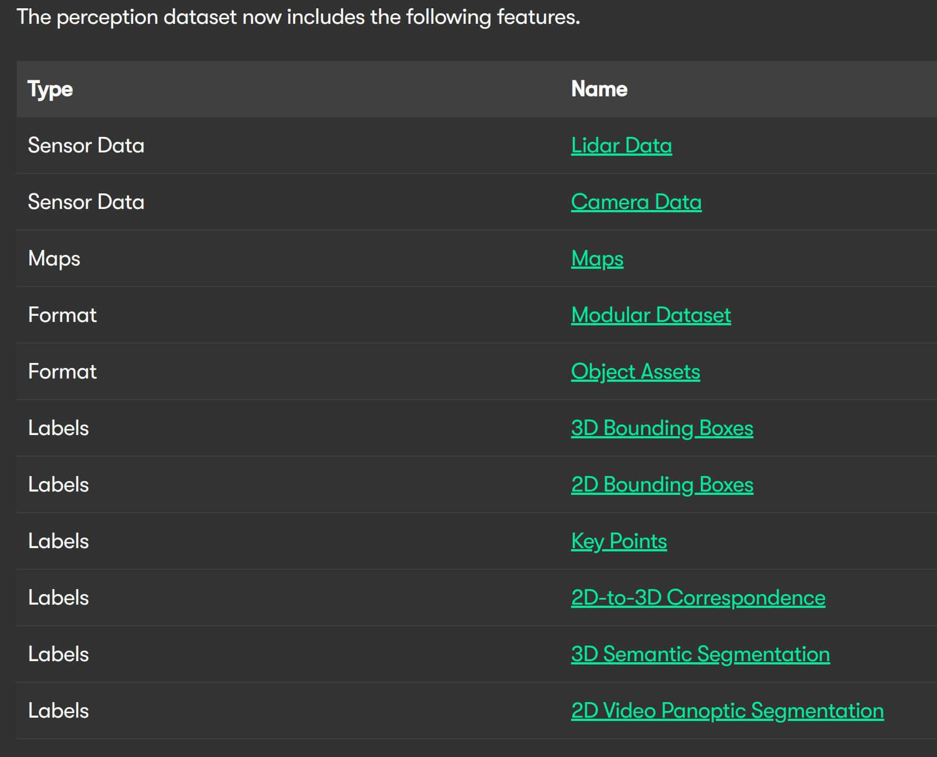
Motivation
The motivation stems from the complexity of autonomous driving data, particularly multi-sensor data (e.g., LiDAR and cameras), which requires specialized skills and resources to process.
The project seeks to bridge the gap between raw data and actionable insights by providing interactive and intuitive visualization tools, aiding researchers and developers in comprehending diverse driving scenarios and supporting the development of autonomous vehicle perception systems.
https://waymo.com/open/data/perception/#lidar-data

Slide 5
Data Source & Background
02

Slide 6



Slide 7
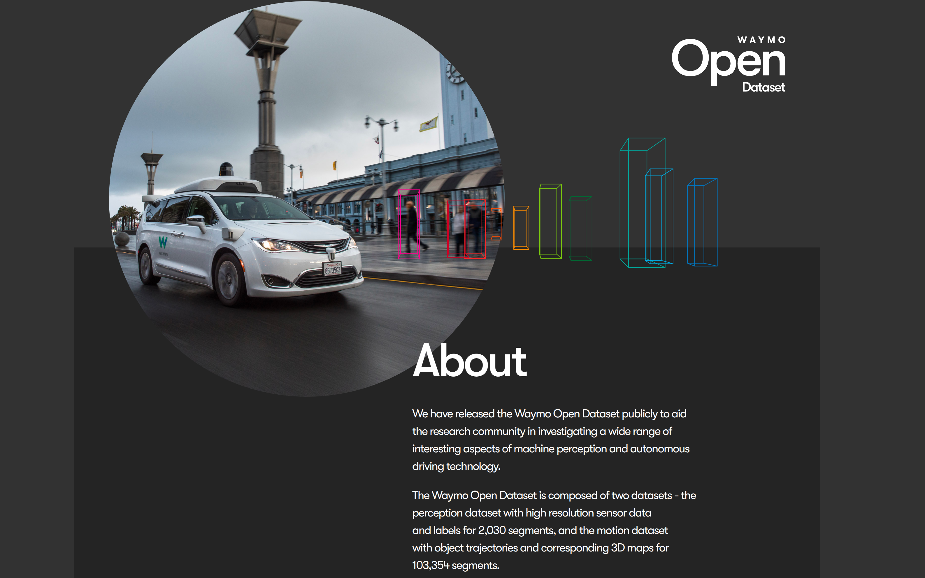

Slide 8
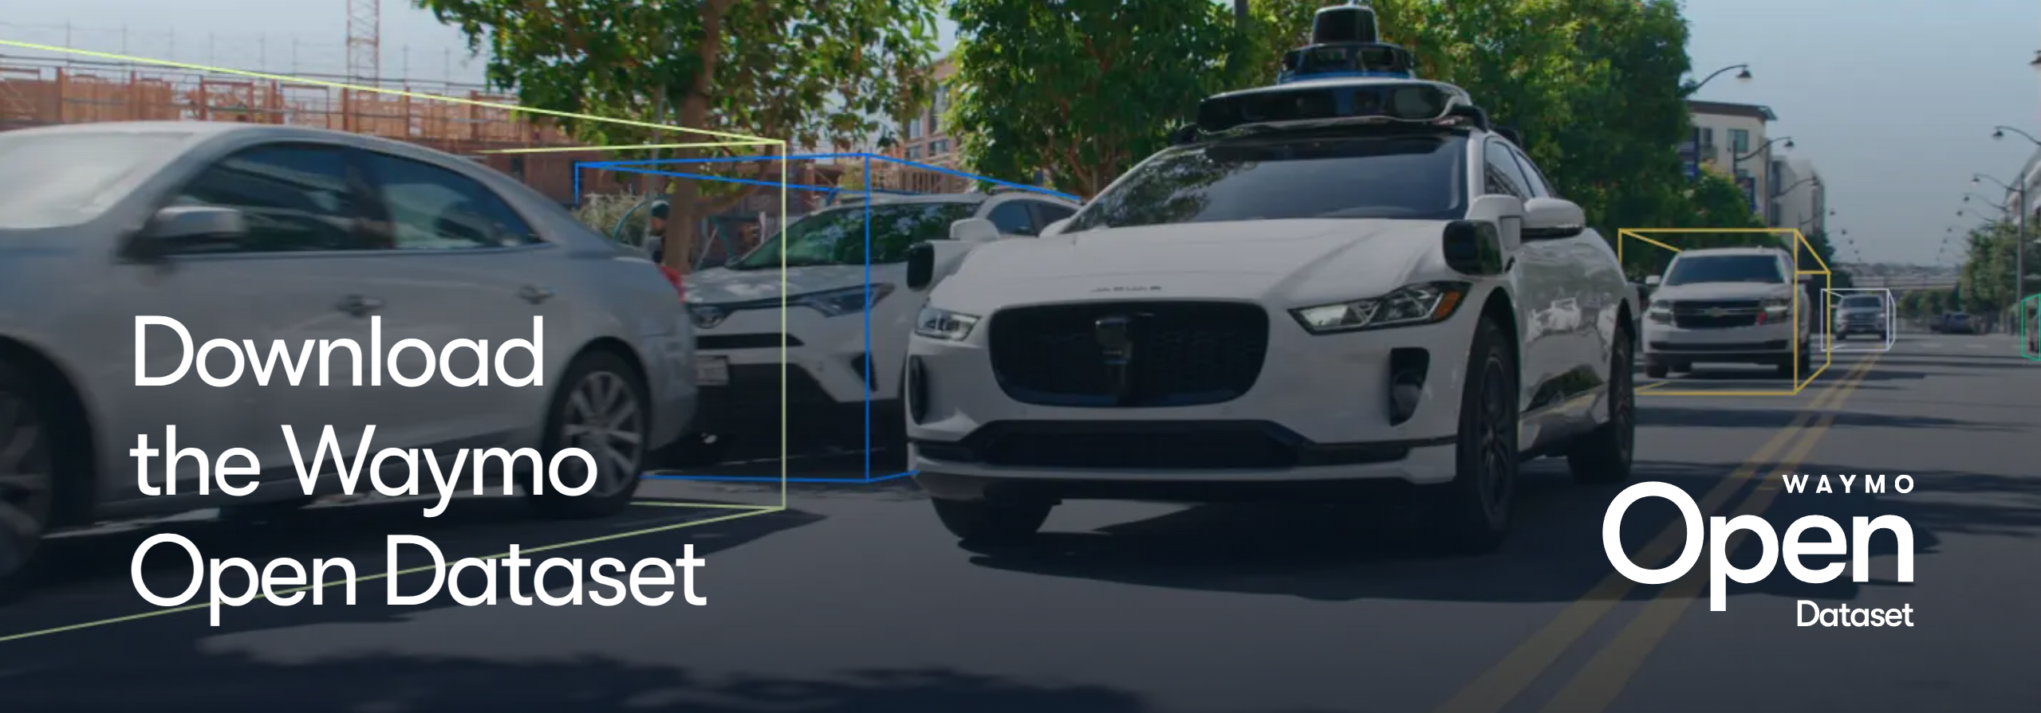
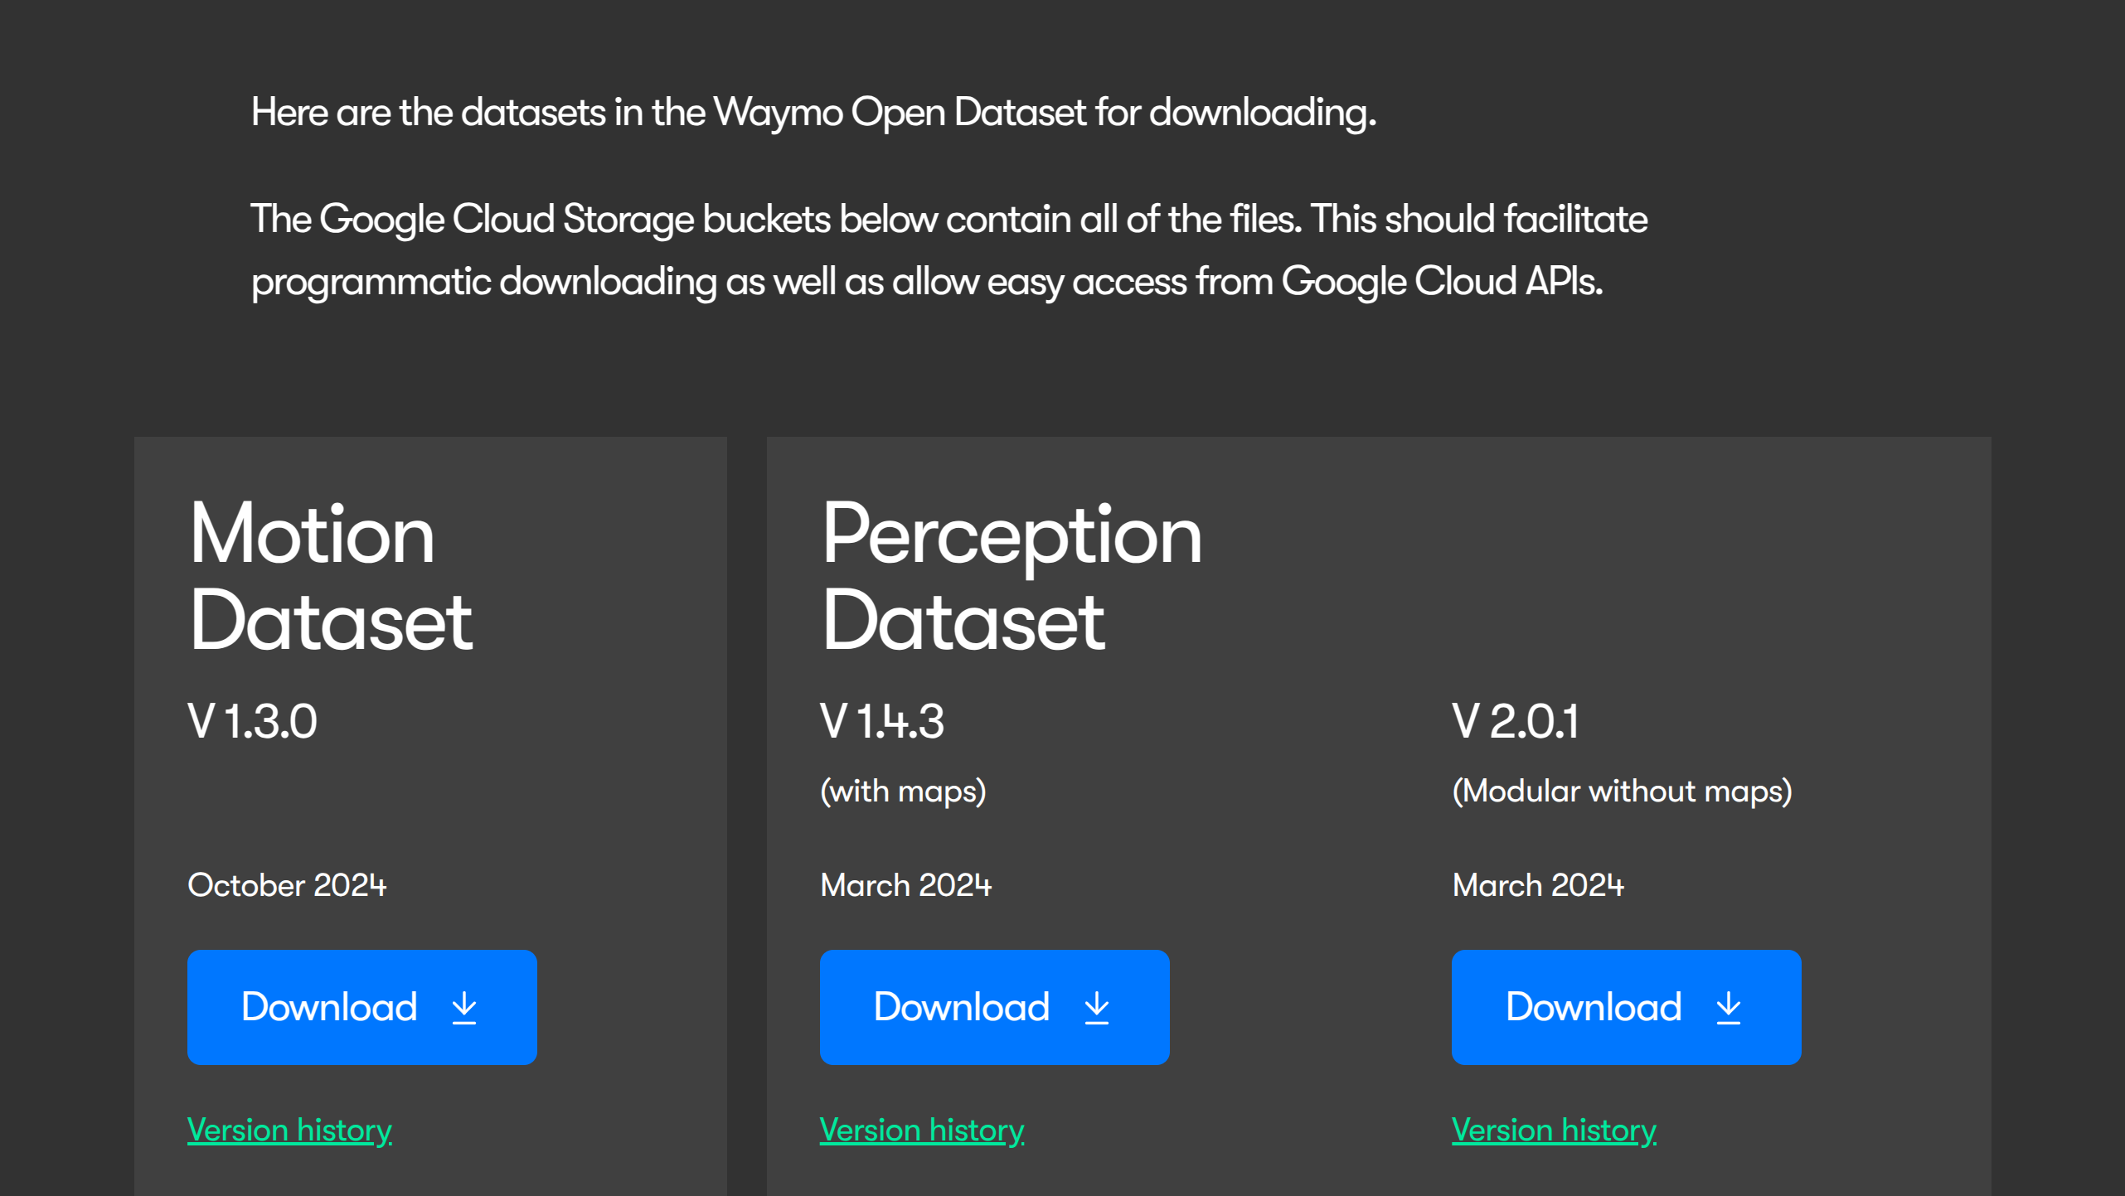

Slide 9
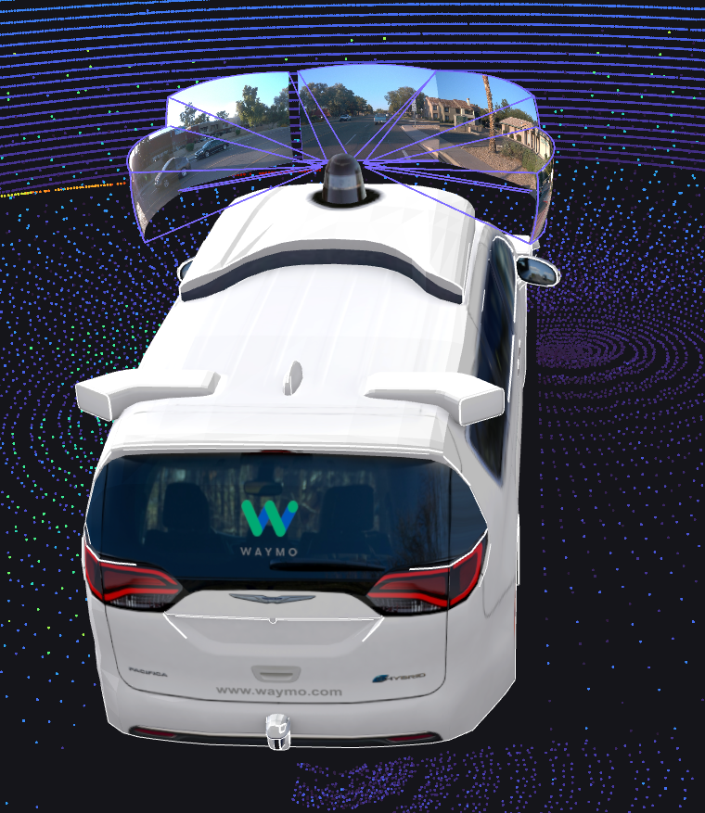
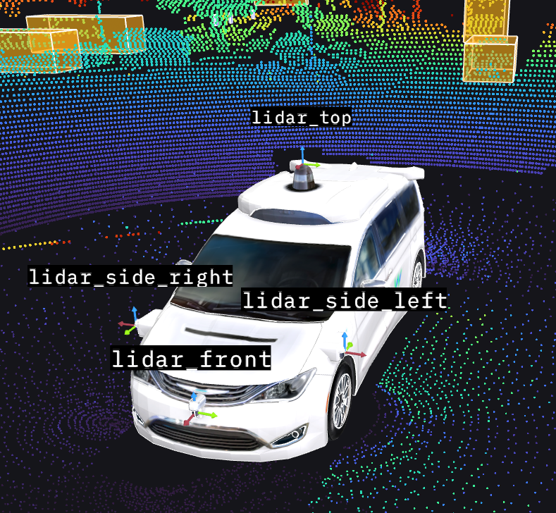
Data Source & Background -- Perception Data Key Features
Multi-sensor Data:
5 LiDARs (1 mid-range 4 short-range)
5 high-resolution cameras.
5 high-resolution cameras
5 LiDARs (1 mid-range 4 short-range)

Slide 10
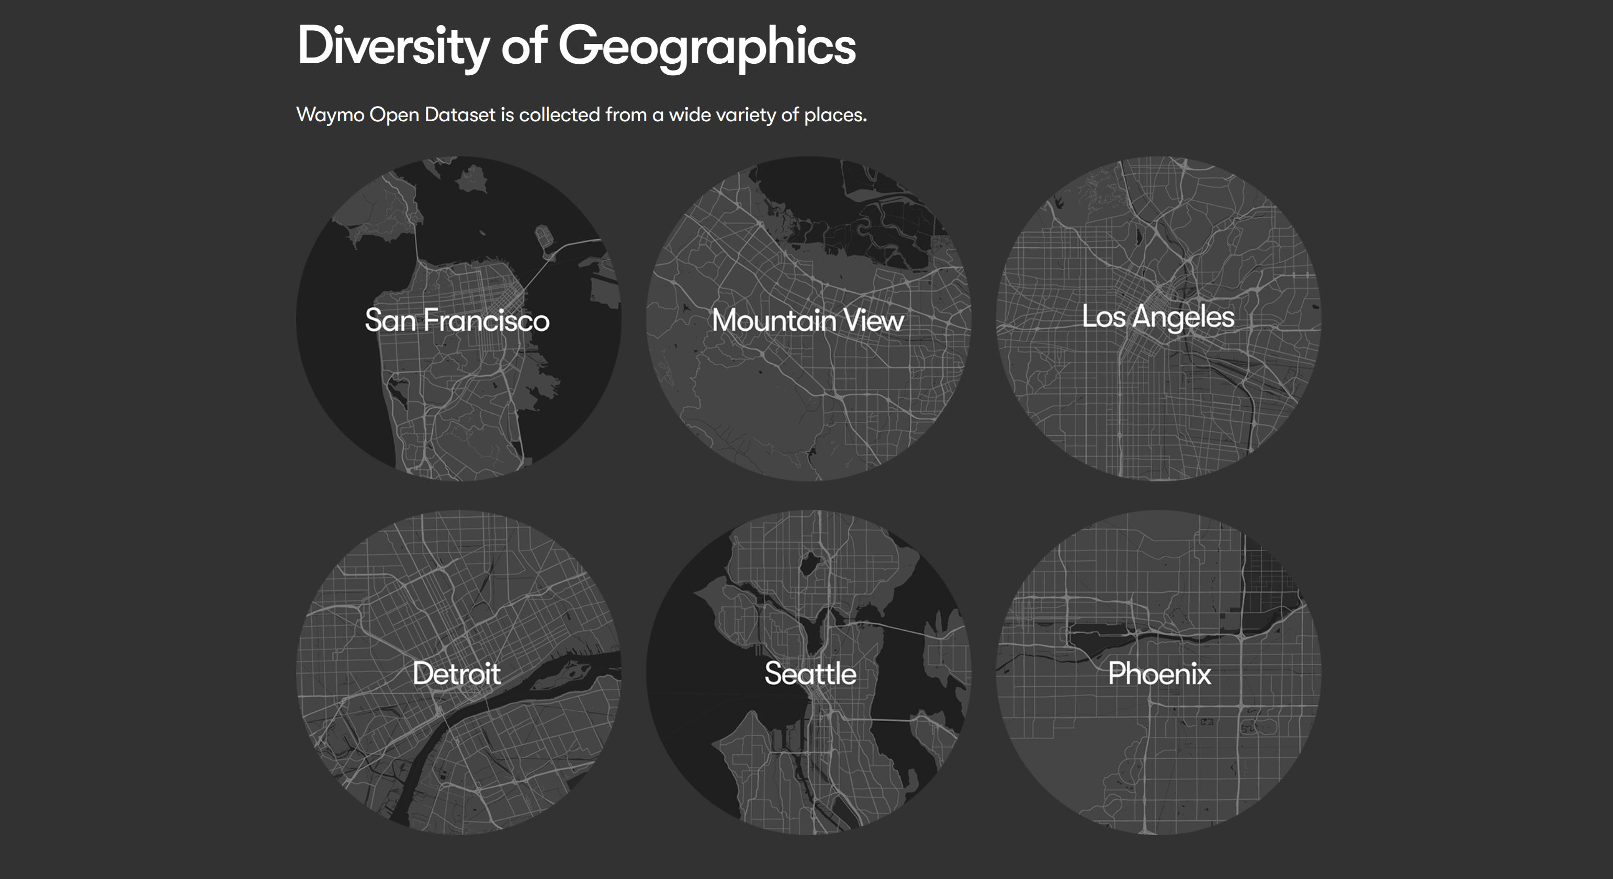

Slide 11
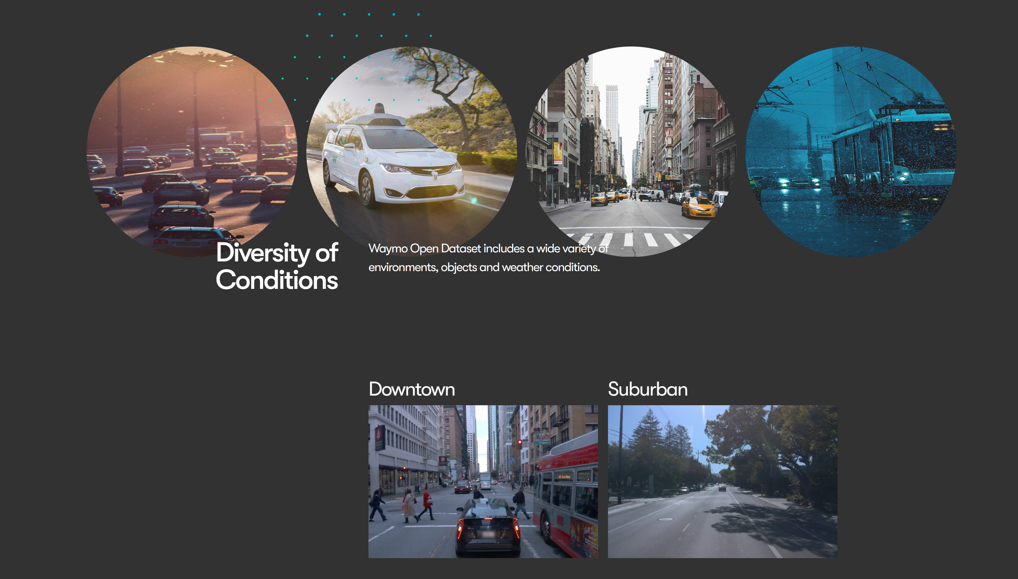

Slide 12
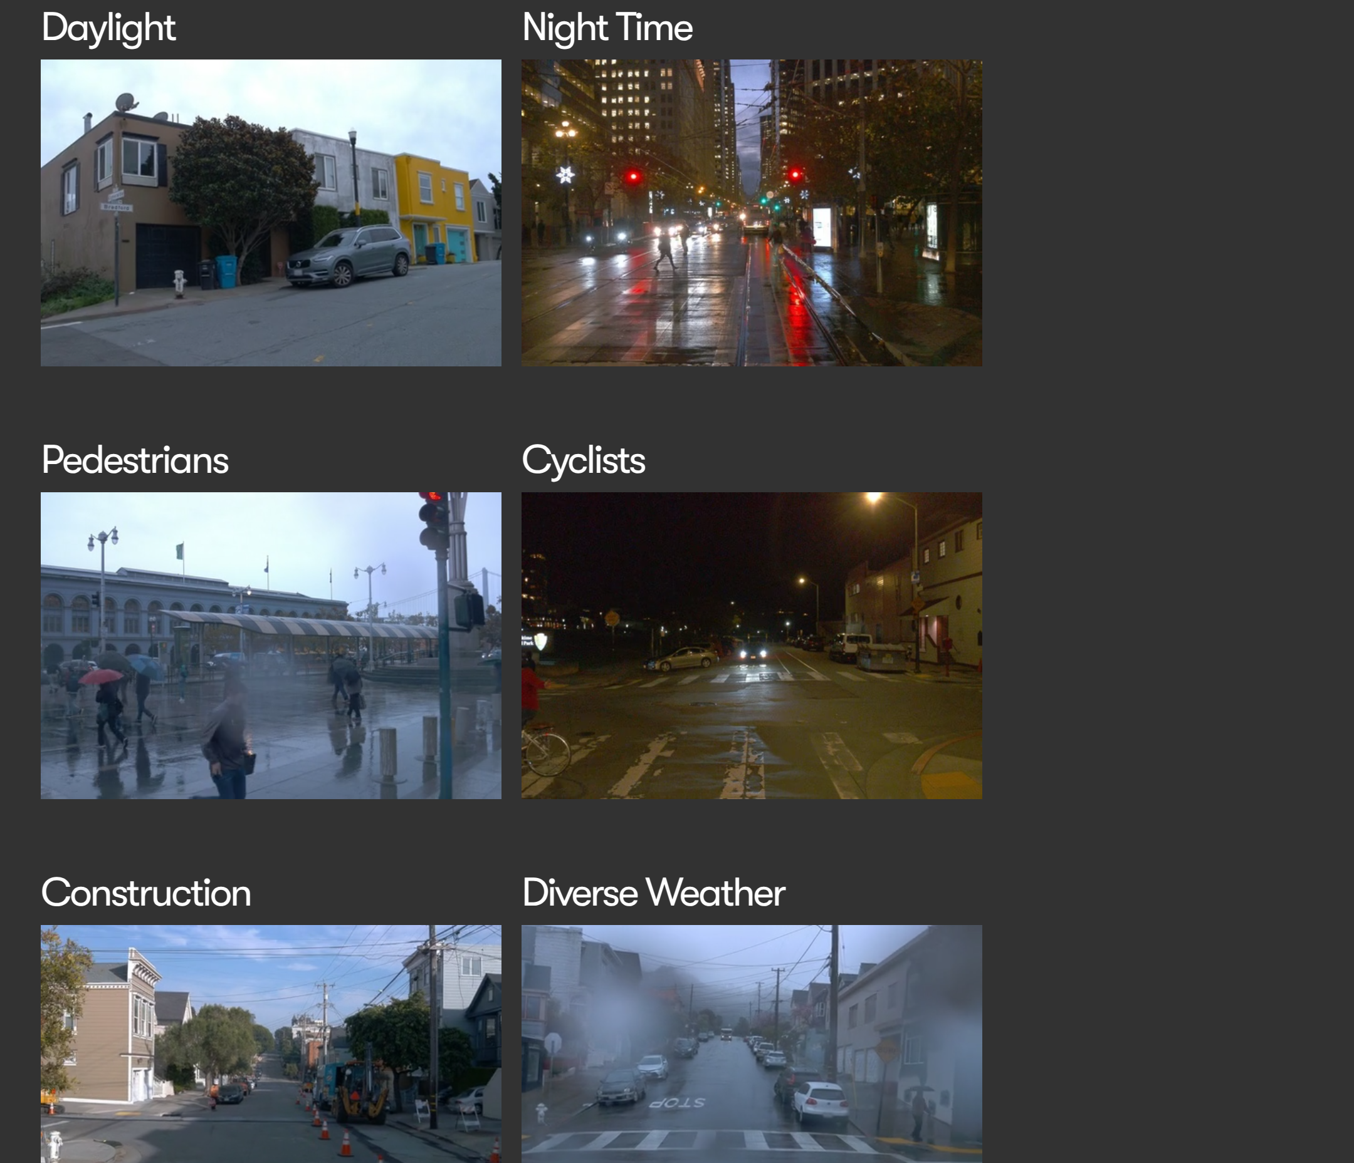

Time and Weather:
Spans day/night and sunny/rainy conditions for testing across scenarios.
Annotation Types:
Includes 1.2M 3D/2D bounding boxes, 3D LiDAR segmentation (23 classes), video panoptic segmentation (28 classes), and 14 human pose keypoints.
Data Volume:
1,950 20-second segments, 600,000 frames, 200,000 km of driving data, plus 1.2M images and LiDAR observations.

Slide 13
Methodology
03

Slide 14
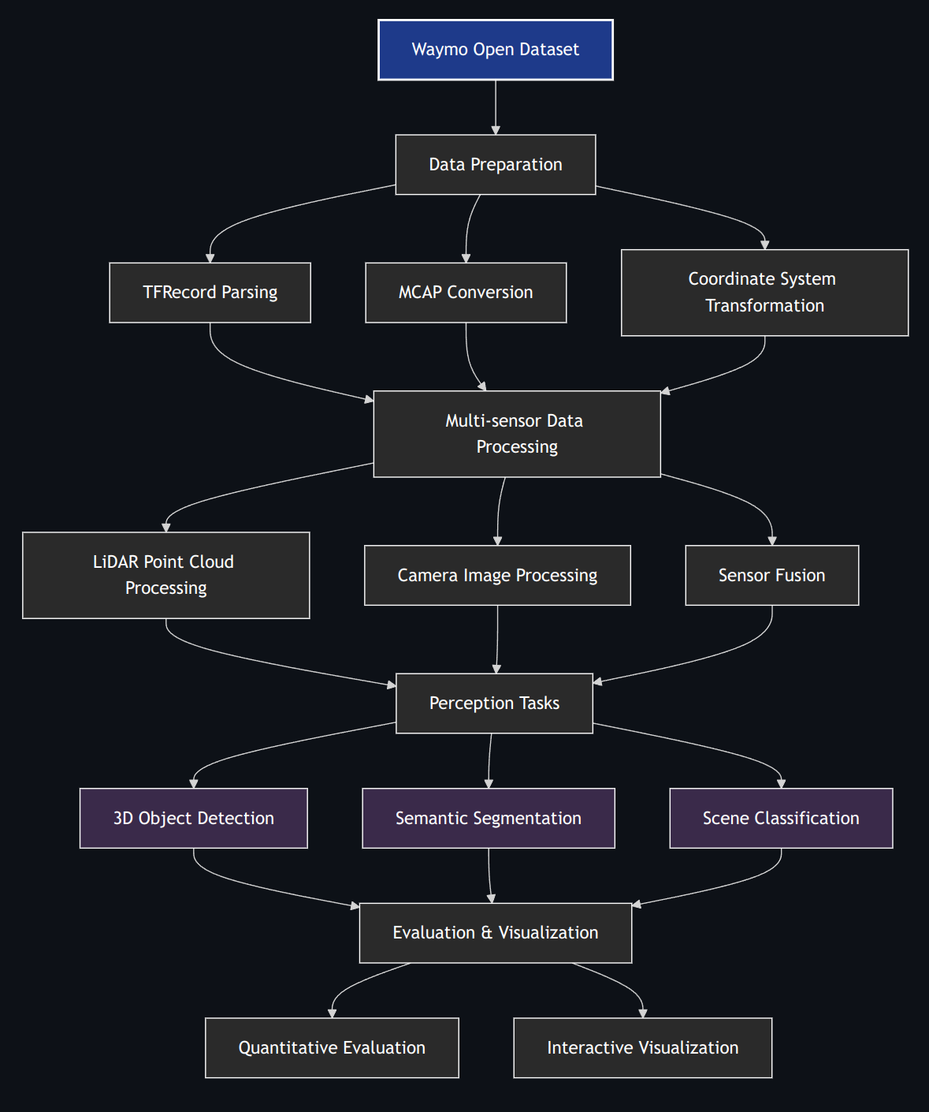
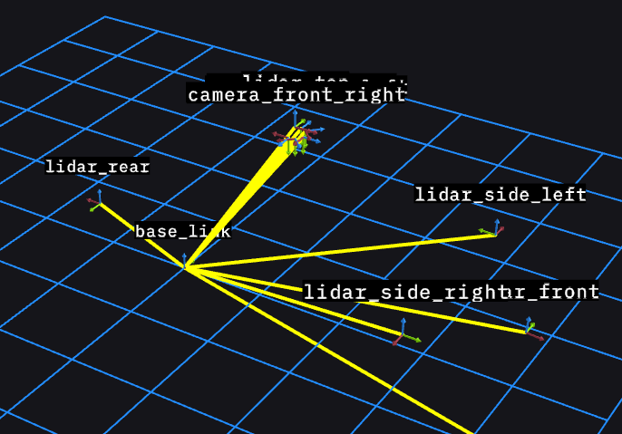
Methodology -- Data Preparation
Transform raw Waymo Open Dataset files into a usable format for analysis and visualization.
Steps:
1. TFRecord Parsing: Load and parse Waymo dataset files (TFRecord format) using TensorFlow. This involves reading compressed data and converting it into protocol buffer objects (dataset_pb2.Frame) for further processing.
2. MCAP Conversion: Convert TFRecord files to MCAP format for compatibility with
Foxglove Studio, enabling interactive visualization.
3. Coordinate System Transformation: Align data from different sensors into a unified coordinate system (e.g., vehicle frame: x-forward, y-left, z-up) using calibration data.

Slide 15
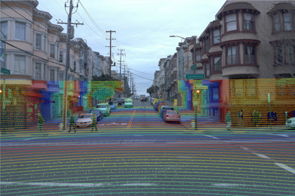
Methodology -- Multi-sensor Data Processing
Process synchronized data from LiDARs and cameras to extract meaningful features.
Components:
LiDAR Point Cloud Processing: Extract and transform LiDAR range images into 3D point clouds, followed by voxel downsampling, ground segmentation, and intensity normalization.
Camera Image Processing: Handle high-resolution camera data, potentially aligning it with LiDAR via projection channels (e.g., x, y coordinates in image space).
Sensor Fusion: Integrate LiDAR and camera data for a cohesive representation of the driving scene.

Slide 16
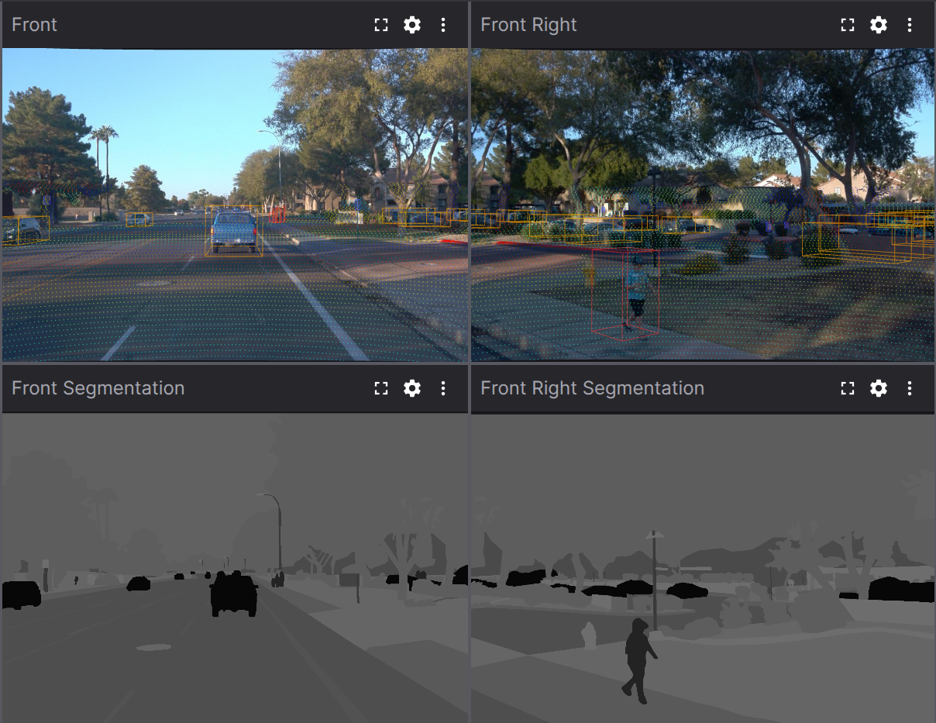
Methodology -- Perception Tasks
Perform advanced analysis on processed data to understand the driving environment.
3D Object Detection: Detect objects (e.g., vehicles, pedestrians) using a pipeline involving Voxel Feature Encoding (VFE), 3D CNN backbone (e.g., PointPillars), Region Proposal Network (RPN), and Non-Maximum Suppression (NMS). Outputs 7-DOF bounding boxes (x, y, z, l, w, h, θ).
Semantic Segmentation: Assign class labels to LiDAR points (23 classes) and camera images (28 classes) using PointNet++ with multi-scale context aggregation and KNN-based feature propagation.
Scene Classification: Categorize scenes based on message topics (e.g., visual_perception, lidar_perception) using a rule-based algorithm integrated with pandas DataFrames.

Slide 17
Methodology -- Tools & Libraries
Foxglove Studio: A visualization platform for rendering MCAP files interactively, integrated via local file loading and layout files (e.g., waymo-scene-layout.json).
TensorFlow: Version 2.5+, used for loading and parsing Waymo TFRecord files, with optional GPU acceleration via CUDA 11.0+.
mcap: Handles MCAP file reading (mcap.reader.make_reader) and writing (mcap.Writer), crucial for data conversion and processing.
tqdm: Provides progress bars for tracking long-running processes (e.g., iterating over MCAP messages).
pandas: Manages data in DataFrame structures, used for feature extraction and scene classification (e.g., features_df.to_csv()).
matplotlib: Generates static and dynamic visualizations like bar charts and histograms.
seaborn: Enhances statistical visualizations, such as boxplots for message size analysis.
waymo_open_dataset: Provides utilities (e.g., dataset_pb2, frame_utils) for parsing Waymo-specific data structures.
plotly: Supports interactive plotting, complementing static visualizations (installed via pip install plotly).
collections (Counter): Analyzes topic distributions efficiently.

Slide 18
Visualization Demo
04

Slide 19
Contributions
05

Slide 20
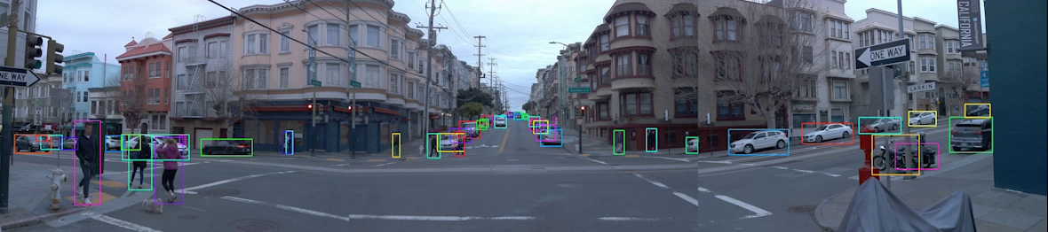
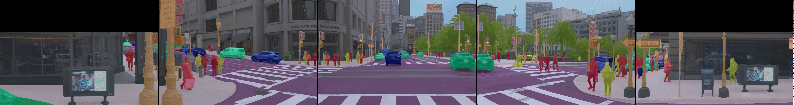
Contributions
Data Accessibility: Simplifies working with the complex Waymo dataset through intuitive visualization tools.
Analysis Framework: Provides a modular framework for analyzing multi-sensor autonomous driving data.
Visualization Techniques: Implements novel visualization approaches for understanding sensor fusion and perception.
Educational Resource: Serves as a learning tool for understanding autonomous driving perception systems.

Slide 21
Future Works
06

Slide 22
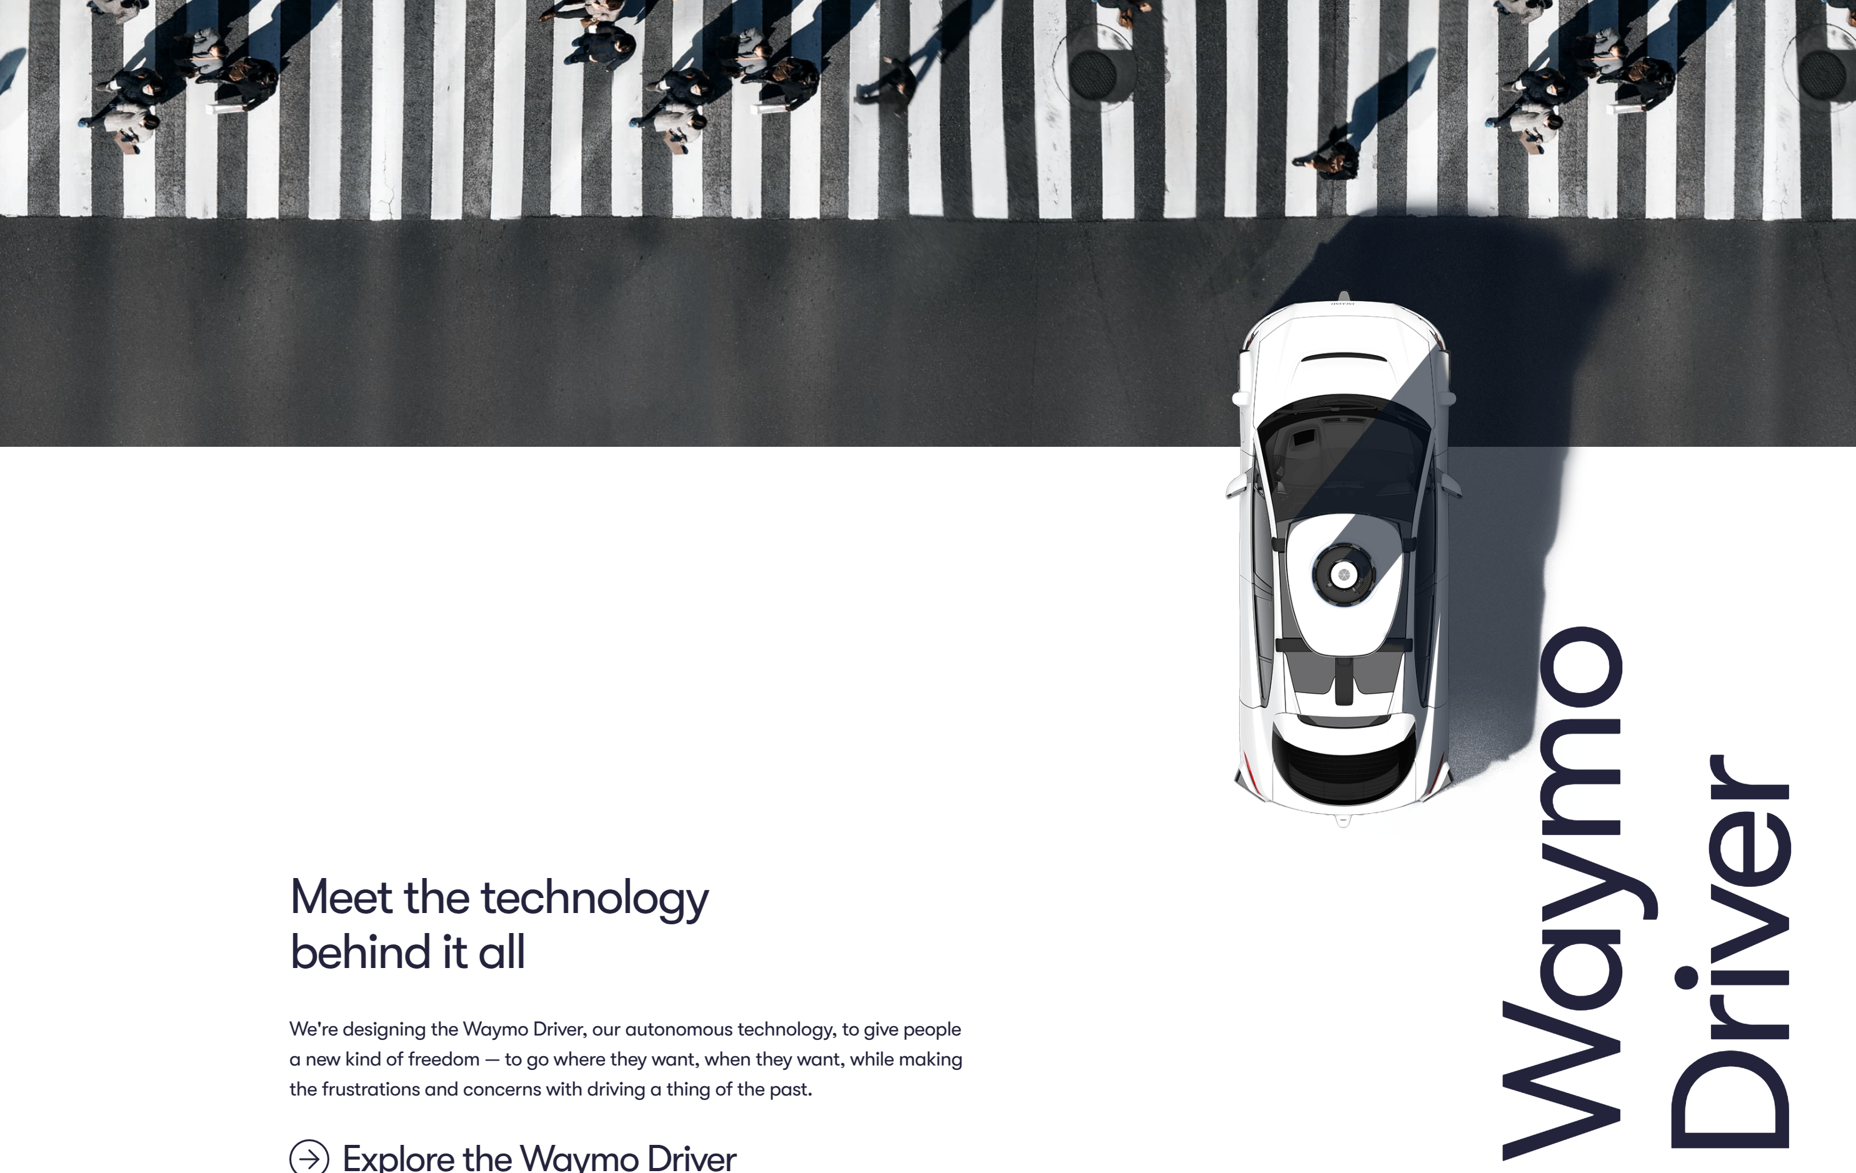

Future Works
Integration with Real-Time Simulation
Goal:
Extend the project to support real-time simulation, aligning with the Sim Agents Challenge’s focus on closed-loop, interactive agent behavior.
Approach:
Incorporate predictive models (e.g., motion transformers) to simulate future trajectories, building on the current time-series and point cloud processing capabilities.

Slide 23
References
07

Slide 24
References
Waymo Team. (2020). *Waymo Open Dataset: Perception Dataset*. Retrieved March 31, 2025, from https://waymo.com/open/data/perception/
MCAP Development Team. (n.d.). *MCAP Format Specification*. Retrieved March 31, 2025, from https://mcap.dev/spec
Foxglove. (n.d.). *Foxglove Documentation*. Retrieved March 31, 2025, from https://foxglove.dev/docs
Foxglove. (n.d.). *Foxglove Studio Download*. Retrieved March 31, 2025, from https://foxglove.dev/download
Foxglove. (2023). *foxglove/studio* [Software]. GitHub. Retrieved March 31, 2025, from https://github.com/foxglove/studio
Open3D Team. (n.d.). *Open3D Documentation: Point Cloud Tutorial*. Retrieved March 31, 2025, from http://www.open3d.org/docs/release/tutorial/geometry/pointcloud.html
OpenMMLab. (2023). *OpenPCDet* [Software]. GitHub. Retrieved March 31, 2025, from https://github.com/open-mmlab/OpenPCDet
Waymo Research. (2023). *Waymo Open Dataset Tutorials*. GitHub. Retrieved March 31, 2025, from https://github.com/waymo-research/waymo-open-dataset/tree/master/tutorial
Sun, P., et al. (2020). Scalability in Perception for Autonomous Driving: Waymo Open Dataset. *Proceedings of the IEEE/CVF Conference on Computer Vision and Pattern Recognition (CVPR)*. arXiv:1912.04838
Mei, J., et al. (2022). Waymo Open Dataset: Panoramic Video Panoptic Segmentation. *European Conference on Computer Vision (ECCV)*. arXiv:2206.07704
Yan, Y., et al. (2023). Occ3D: A Large-Scale 3D Occupancy Prediction Benchmark for Autonomous Driving. *Advances in Neural Information Processing Systems (NeurIPS)*. arXiv:2304.14365
Yin, T., et al. (2023). FastFlow3D: A Lightweight Scene Flow Estimator for LiDAR Point Clouds. *IEEE International Conference on Robotics and Automation (ICRA)*. arXiv:2206.07704
Lang, A., et al. (2019). PointPillars: Fast Encoders for Object Detection from Point Clouds. *Proceedings of the IEEE/CVF Conference on Computer Vision and Pattern Recognition (CVPR)*. DOI:10.1109/CVPR.2019.00498
Shi, S., et al. (2020). PV-RCNN: Point-Voxel Feature Set Abstraction for 3D Object Detection. *Proceedings of the IEEE/CVF Conference on Computer Vision and Pattern Recognition (CVPR)*. arXiv:1912.13192
Zhou, Z., et al. (2021). Cylinder3D: An Effective 3D Framework for Driving-Scene Segmentation. *Proceedings of the IEEE/CVF Conference on Computer Vision and Pattern Recognition (CVPR)*. arXiv:2008.01550
Milioto, A., et al. (2019). RangeNet++: Fast and Accurate LiDAR Semantic Segmentation. *IEEE/RSJ International Conference on Intelligent Robots and Systems (IROS)*. arXiv:1904.08790
Zhao, H., et al. (2020). TNT: Target-driven Trajectory Prediction. *Conference on Robot Learning (CoRL)*. arXiv:2008.08294
Salzmann, T., et al. (2020). Trajectron++: Dynamically-Feasible Trajectory Forecasting with Heterogeneous Agents. *European Conference on Computer Vision (ECCV)*. arXiv:2001.03093
Gulino, C., et al. (2023). Waymax: An Accelerated, Data-Driven Simulator for Large-Scale Autonomous Driving Research. *Conference on Robot Learning (CoRL)*. arXiv:2310.08710
Dosovitskiy, A., et al. (2017). CARLA: An Open Urban Driving Simulator. Conference on Robot Learning (CoRL). arXiv:1711.03938.

Slide 25
Task Allocation
08

Slide 26
Task Allocation
Jingjie Qian:
Data Preparation: Perform TFRecord parsing and MCAP conversion.This includes loading Waymo dataset TFRecord files, parsing them into usable data structures, and converting them to MCAP format for compatibility with visualization tools like Foxglove Studio. It requires understanding data formats, compression handling, and basic scripting automation.
Perception: Develop scene classification algorithms.This involves creating rule-based or machine learning models to classify driving scenes (e.g., urban, highway) based on sensor data topics. It requires working with pandas DataFrames and ensuring the classification algorithm is accurate and generalizes across different scenarios.
Visualization: Generate time-series data visualizations and statistical analysis dashboards.Using libraries like Matplotlib and Seaborn, create charts such as topic distribution plots, message size boxplots, and time-series histograms to analyze data trends and system performance over time.
Rongxuan Zhou:
Data Processing: Handle LiDAR point cloud, camera image processing, and sensor fusion.This involves managing complex multi-sensor data, such as extracting 3D point data from LiDAR range images, aligning camera images with LiDAR data, and fusing multi-source data into a unified scene representation. It requires expertise in sensor algorithms, coordinate transformation techniques, and efficient, accurate processing of large-scale data.
Perception: Implement 3D object detection and semantic segmentation.This includes developing and applying advanced machine learning models (e.g., PointPillars for object detection and PointNet++ for semantic segmentation) to identify objects like vehicles and pedestrians in 3D space and assign semantic labels to LiDAR point clouds and camera images. It demands skills in computer vision, model optimization, and handling large datasets.
Visualization: Create interactive 3D scene rendering and multi-sensor data fusion displays.This requires using tools like Foxglove Studio and Matplotlib to visualize point clouds, object detection results, and segmented scenes. The focus is on rendering complex 3D environments and ensuring visualizations are intuitive and interactive for analysis and debugging.
Malia Howe:
Data Preparation: Manage coordinate system transformations.This involves using calibration data to transform sensor data between different coordinate systems (e.g., global, vehicle, sensor frames). It requires knowledge of linear algebra and transformation matrices to ensure accurate alignment of multi-sensor data.
Documentation and Tutorials: Write README files, tutorial notebooks, and project documentation.This includes creating clear, user-friendly guides for project setup, tool usage, and understanding the codebase. The goal is to make the project accessible to both technical and non-technical users through well-structured documentation and step-by-step tutorials.
Testing and Validation: Conduct unit and integration testing.This involves writing and running test cases to ensure the stability and reliability of the codebase, covering data processing pipelines, perception models, and visualization tools. It requires familiarity with testing frameworks and a focus on identifying and resolving potential errors or inconsistencies.

Slide 27
Q&A

